Slide 1


Department of Computer Science and Engineering
FACE DETECTION AND RECOGNITION FOR CRIMINAL IDENTIFICATION SYSTEM
SRIDHAYAA A S (211419104324)
ISWARYA G (211419104501)
RAMYA P (211419104322)
Guide Name
Mrs.V.SATHYA PREIYA, M.E., (Ph.D.)
Coordinator
Dr.K.VALARMATHI, M.E., Ph.D.

Slide 2
INTRODUCTION
Crime is one of our societies most serious and pervasive issues, and preventing it is a critical duty. Certain types of criminal incidents such as larceny, identity theft, or even pickpocketing can cause disturbance and stress in an individual’s life and affect his mental peace.
The use of large numbers of closed circuit television systems (CCTV) in both public and private settings has been considered a necessary in response to rising concerns about crime and its danger to security and safety.
The face is a terrific tool for identifying people, and each one is distinctive since it can be easily distinguished. This system uses the two important approaches of detection and identification.
Two crucial strategies are triggered by face attention: training and evaluation. The facial recognition system's assessment section compares the recently acquired check photo with the database that already exists. If the data is matched with the database a email is triggered to the concern officials.

Slide 3
OBJECTIVE OF THE PROJECT
This paper presents a methodology for recognizing the human face based on the features derived from the image.
As the human face is a complex multidimensional visual representation, it is extremely challenging to create a computational model for identifying it.
The video captured by the camera will be translated into frames as part of the suggested process.
We proposed an improved texture classification algorithm local binary pattern (LBP)with histograms of oriented gradient HOG descriptor to improve detection accuracy.
When a face is found in a frame, it is preprocessed to remove redundant information and minimize noise.
The real-time processed image is compared to the trained images that have previously been saved in the database. The technology will send an automatic email notice to the police officials if the surveillance camera detects a criminal.

Slide 4
LITERATURE SURVEY
S.NO | NAME OF THE PAPER WITH YEAR | AUTHORS | OBJECTIVE | PUBLISHER
1 | Face Detection and Recognition for Criminal Identification System (2022) | Sanika Tanmay Ratnaparkhi, Aamani Tandasi | This paper explores a way to develop a criminal identification system using ML and deep neural networks. The following method can be used as an elegant way to make law enforcement hassle-free. | IEEE
2 | Criminal Face Detection (2022) | Prajyot Rupanvar, Vishvajit Kale | This project is intended to identify a person using the images previously taken. The identification will be done according the previous images of different persons. | Journal of Advances in Science and Technology (JAST)

Slide 5
LITERATURE SURVEY (contd..)
S.NO | NAME OF THE PAPER WITH YEAR | AUTHORS | OBJECTIVE | PUBLISHER
3 | Face Detection System with Face Recognition (2022) | Prof. Anup Bhange, Ms. Vishakha I. Dhanjode | The goal of this project is to provide easier human-machine Interaction routine, When user authentication is needed through face detection and recognition. | International Journal for Research in Applied Science & Engineering Technology (IJRASET)
4 | Criminal Identification by Using Real Time Image Processing (2021) | Tiwari Aanchaladevi S, Ghotekar Shubhangi S. | The main goal of this paper is to help in real time for face recognition by using automated face surveillance camera. | International Journal of Research in Engineering and Science (IJRES)

Slide 6
LITERATURE SURVEY (contd..)
S.NO | NAME OF THE PAPER WITH YEAR | AUTHORS | OBJECTIVE | PUBLISHER
5 | online criminal identification using ml & face recognition Techniques (2021) | ganta tejaswini, kesavarao seerapu | The scope of the project is confined to store the image and store in the database. When a person has to be identified the images stored in the database are compared with the existing details. | Journal of Emerging Technologies and Innovative Research (JETIR)
6 | Automated Criminal Identification System using Face Detection and Recognition (2019) | Piyush Chhoriya | This paper presents a real-time face recognition using an automated surveillance camera. This system will be able to detect and recognize face automatically in real-time. | International Research Journal of Engineering and Technology (IRJET)

Slide 7
PROBLEM STATEMENT
This system is aimed to identify the criminals in any investigation department. In this system, we are storing the images of criminals in our database along with his details and then these images are segmented into four slices- forehead, eyes, nose and lips.
These images are again stored in another database record so as to make the identification process easier. Eyewitnesses will select the slices that appear on the screen and by using it we retrieve the image of the face from the database.
Thus this system provides a very friendly environment for both the operator and the eyewitness to easily identify the criminal, if the criminals record exists in the database.
This project is intended to identify a person using the images previously taken.

Slide 8
EXISTING SYSTEM
The Existing System is single face recognition system and a new face detection approach using color base segmentation and morphological operations is presented.
The algorithm uses color plane extraction, background subtraction, thresholding, morphological operations (such as erosion and dilation), filtering (to avoid false detection).
Then particle analysis is done to detect only the face area in the image and not the other parts of the body.
This method given result is poor performance and accuracy

Slide 9
PROPOSED SYSTEM
The proposed system consists of 4 steps, including training of real time images, multiple face detection, comparison of trained real time images with images from the surveillance camera, result based on the comparison.
In our proposed system, the video obtained from the camera will be converted into frames.
When a face is detected in a frame, it is preprocessed where noise and redundancies are reduced.
The processed real time image is compared with the processed images already stored in the database.
If he is criminal/suspect, we get a notification from android through firebase.

Slide 10
SOFTWARE / HARDWARE USED
HARDWARE REQUIREMENTS:
Hard Disk : 500GB and Above
RAM : 4GB and Above
Processor : I3 and Above
Webcam – 1
SOFTWARE REQUIREMENTS:
Operating System : Windows 10 (64 bit)
Software : Python
Tools : Anaconda

Slide 11







ARCHITECTURE DIAGRAM
Camera
Image
Pre-Processing
Feature Extraction
Algorithm
Criminal
Non-Criminal
Firebase
Android Notification

Slide 12
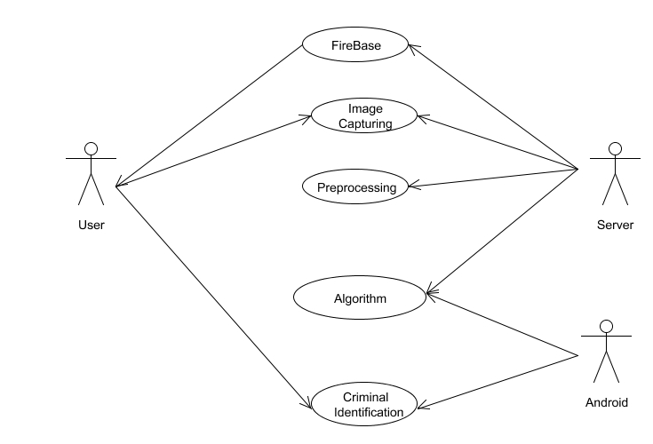
SYSTEM DESIGN
Use Case Diagram

Slide 13
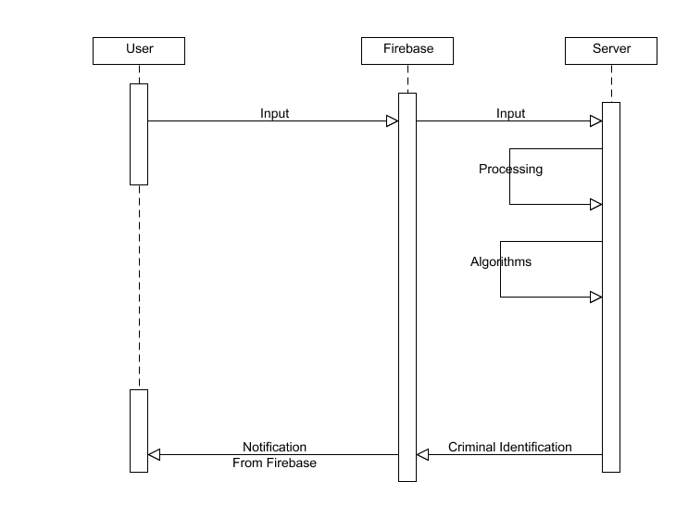
SYSTEM DESIGN (contd..)
Sequence Diagram

Slide 14
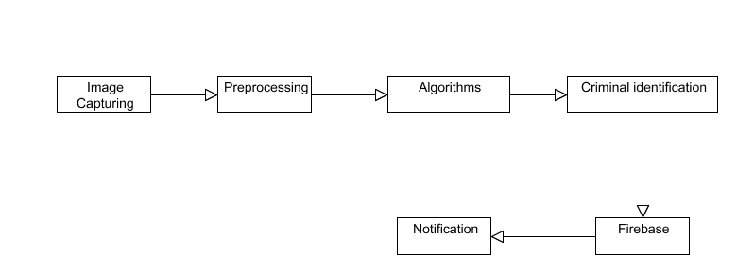
SYSTEM DESIGN (contd..)
Collaboration Diagram

Slide 15
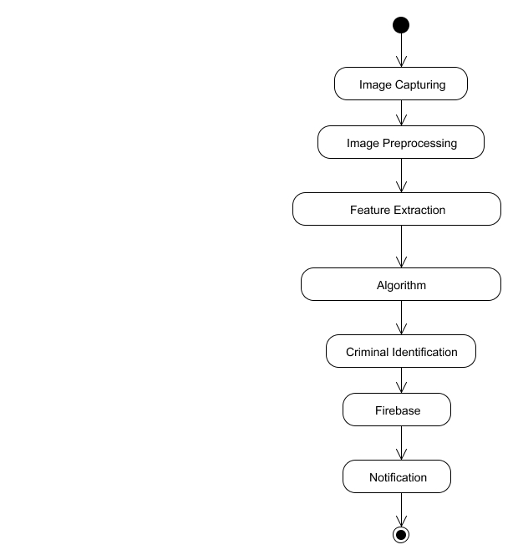
SYSTEM DESIGN (contd..)
Activity Diagram

Slide 16
MODULE DESCRIPTION
MODULES
Face Detection
Creation of Dataset
Training Faces
Face Recognition

Slide 17
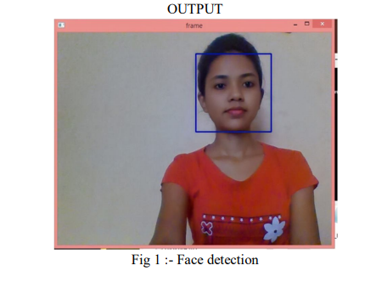
MODULE DESCRIPTION (contd..)
Face Detection:
Face detection just mean that a system is able to identify that there is a human face present in an image and video, And this is possible using Haar cascade classifier.
A Haar classifier or Haar cascade classifier, is a machine learning object detection program that identifies objects in an image and video.
We can detect different parts of the human body using Haar cascade classifier like eyes, nose, face, etc.
To detect the any part of the human body, there is different xml files are available, for eg. To detect the face we use Haarcascade_frontalface_default.xml file, OpenCv already contains this file.
After that set the border using rectangle() to show the detected faces in zero or more bounding boxes.

Slide 18
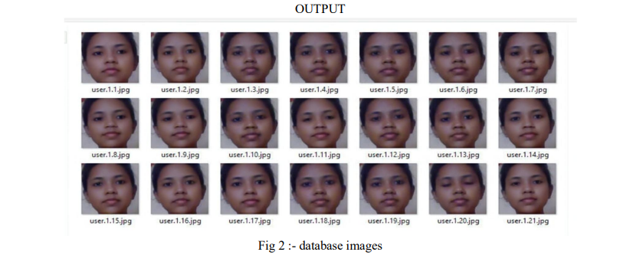
MODULE DESCRIPTION (contd..)
Creation of Dataset :
Create a dataset to add information to recognize the person in the image or video.
For this first set the id for that person whose face is detected, then using this id we can set the other information while face recognition.
Here we can create our own dataset or start with the available face databases.
The input for the dataset is user id, it can be different for different faces.
After capturing the image from webcam, set the id for that image and save it into a particular folder for use of another program.
The images are save in the folder that we mentioned.

Slide 19
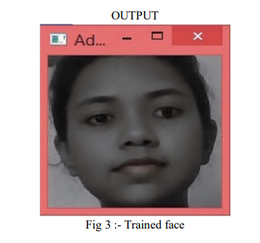
MODULE DESCRIPTION (contd..)
Training Faces :
Using the training faces, all face dataset converted into a single .yml file.
For this we have trainingdata.yml file saved in a particular folder .
Create the function to prepare the training set: Now, we will define a function
getImageWithId(path)
That takes the absolute path to the image dataset as input argument and returns tuple of two list, one containing the detected faces and the other containing the corresponding lable for that face.
For example, if the ith index in the list of faces represents the 5th individual in the database , then the corresponding ith location in the list of labels has value equal to 5.
Then covert the dataset faces (which is created in Creation of dataset ) into .yml file.

Slide 20
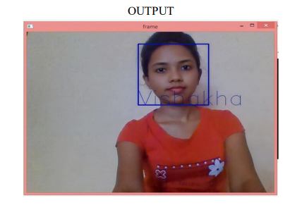
MODULE DESCRIPTION (contd..)
Face Recognition:
This is the final step of the program that the face recognition process.
In this we are going through following two steps:
1)Capturing the video from Webcam
2) Compare it with .yml file
a)Capturing video from Webcam:
Here, we can capture the image through Webcam as an input.
b) Compare it with .yml file:
After capturing the image from Webcam, The image will compare with .yml file. And then finally we got an output as an image with their identity like, the name of the person, age, etc....

Slide 21
TESTCASES
TEST REPORT : 01
USECASE : DETECT CRIMINAL
Req_Id | Tkt_Id | Req_description | Actual_o/p | Expected_o/p | Tkt_status
1 | 201 | Upload image from pictures and if criminal is found | Criminal details will be displayed | Criminal details will be displayed | PASS
 | 202 | Upload image from pictures and if criminal is not found | No criminal recognized message | No criminal recognized message | PASS

Slide 22
TESTCASES (contd..)
TEST REPORT: 02
USECASE : CAMERA SURVEILLANCE
Req_Id | Tkt_Id | Req_description | Actual_o/p | Expected_o/p | Tkt_status
2 | 301 | Web cam will be opened for live surveillance | Web cam will open successfully and will start recognizing criminals | Web cam will open successfully and will start recognizing criminals | PASS
 | 302 | Web cam will be opened for live surveillance | Web cam won’t open due to some access privileges | Web cam will open successfully and will start recognizing criminals | FAIL

Slide 23
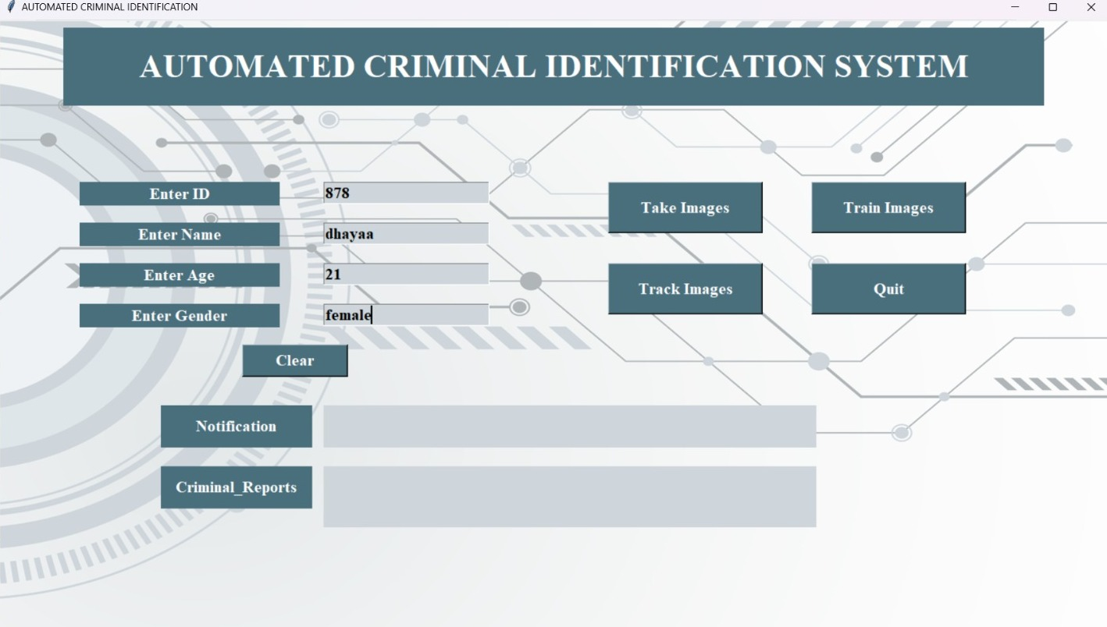
SCREENSHOTS
Entering the Details of the Criminal

Slide 24
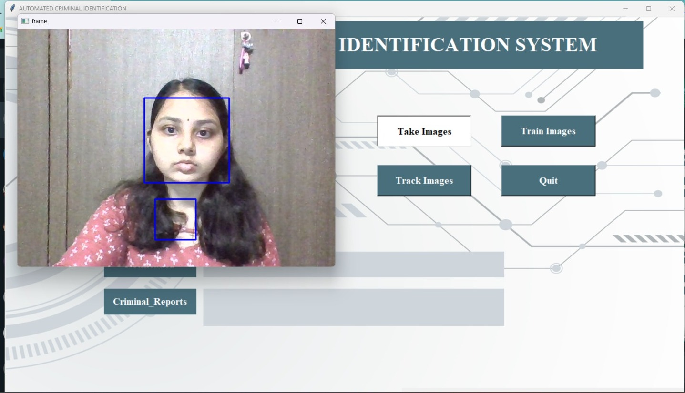
SCREENSHOTS (contd..)
Face Detection of the Criminal

Slide 25
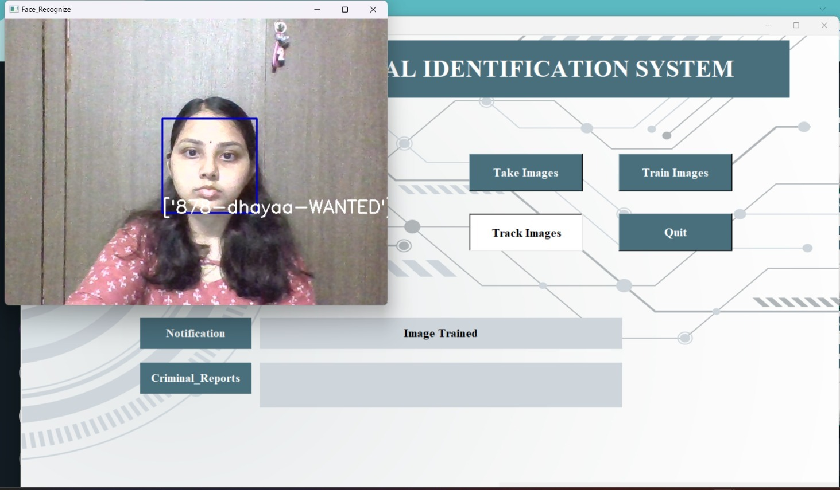
SCREENSHOTS (contd..)
Face Recognition of the Criminal

Slide 26

SCREENSHOTS (contd..)
Notification of Criminal Identification through android app

Slide 27
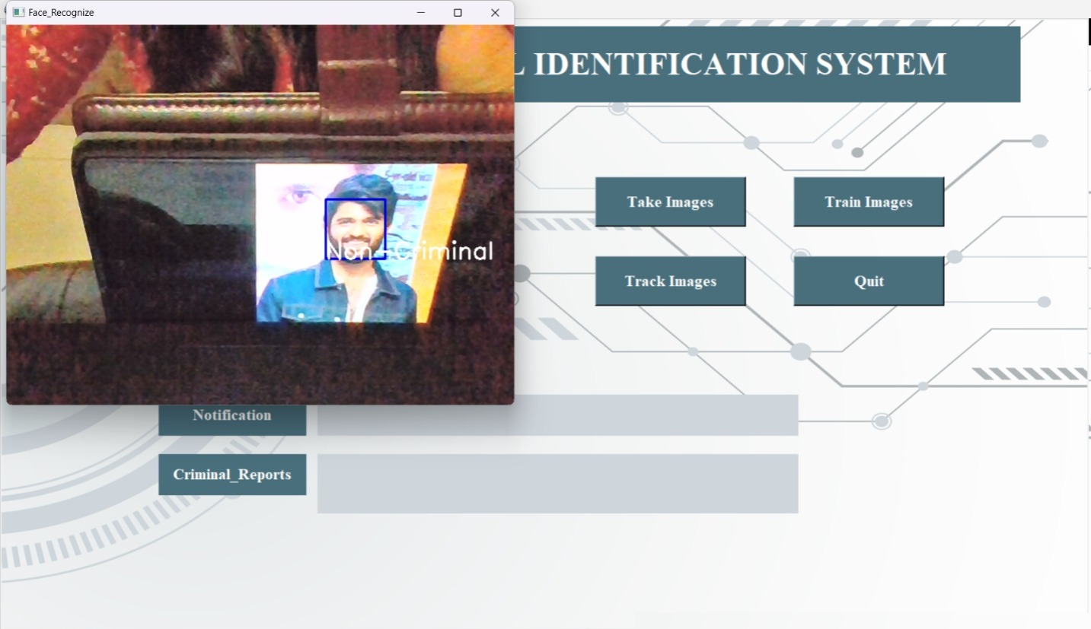
SCREENSHOTS (contd..)
Face Detection of the Non-Criminal

Slide 28
CONCLUSION/FUTURE ENHANCEMENT
In addition to offering the Police great convenience in identifying criminals, this enhanced version of the criminal detection system also saves them time because operations are automated. This project is unique in that it uses face encodings to detect faces.
For future work, we can add the Alarms to the criminal detection system. It will only sound when a match is made, letting anyone who isn't watching the CCTV room know that someone from the database has been located in that public area. It presents a surveillance system that will give us alerts when any controversy, fight, or intruder is detected by using CCTV footages.

Slide 29
REFERENCES
[1] Alireza Chevelwalla,” Criminal Face Recognition System”, International Journal of Engineering Research & Technology (IJERT) ISSN: 2278-0181 IJERTV4IS030165 ,Vol. 4 Issue 03, March-2015.
[2] Kaipeng Zhang, “Joint Face Detection and Alignment using Multi-task Cascaded Convolutional Networks” ,in IEEE Signal Processing Letters ( Volume: 23, Issue: 10, October 2016), DOI: 10.1109/LSP.2016.2603342.
[3] Nurul Azma Abdullah, “Face Recognition for Criminal Identification: An implementation of principal component analysis for face recognition”, in the 2nd International Conference on Applied Science and Technology 2017 (ICAST’17) AIP Conf. Proc. 1891, 020002-1–020002-6; AIP Publishing. 978-0-7354-1573-7.
[4] Piyush Kakkar, “Criminal Identification System Using Face Detection and Recognition”, in the International Journal of Advanced Research in Computer and Communication Engineering ISO 3297:2007 Certified Vol. 7, Issue 3, March 2018, DOI 10.17148/IJARCCE.2018.7346.
[5] Archana Naik, “Criminal identification using facial recognition”, in the International Journal of Advance Research, Ideas and Innovations in Technology, ISSN: 2454-132X Impact factor: 4.295 (Volume 5, Issue 3), 2019.
[6] Piyush Chhoriya, “Automated Criminal Identification System using Face Detection and Recognition”, international Research Journal of Engineering and Technology (IRJET) e-ISSN: 2395-0056 Volume: 06 Issue: 10, Oct 2019.

Slide 30
REFERENCES (contd..)
[7] Aakriti Singhal, “Criminal Face Detection System”, International Journal of Advance Research and Innovation, Volume 9 Issue 2 (2021) 188-191.
[8] D.Nagamallika, “ Criminal Identification System Using Deep Learning”, JETIR July 2021, Volume 8, Issue 7, JETIR2107217.
[9] Ganta Tejaswini, ”ONLINE CRIMINAL IDENTIFICATION USING ML & FACE RECOGNITION TECHNIQUES”, JETIR December 2021, Volume 8, Issue 12, JETIR2112098.
[10] KH Teoh, “Face Recognition and Identification using Deep Learning Approach”, 5th International Conference on Electronic Design (ICED) 2020 Journal of Physics: Conference Series 1755 (2021) 012006 IOP Publishing doi:10.1088/1742-6596/1755/1/012006.
[11] Nagnath B. Aherwadi, “Criminal Identification System using Facial Recognition”, Aherwadi, (July 12, 2021). Proceedings of the International Conference on Innovative Computing & Communication (ICICC) 2021.
[12] Saniya Prashant Patil, “CRIMINAL IDENTIFICATION FOR LOW RESOLUTION SURVEILLANCE”, VIVA Institute of Technology 9 th National Conference on Role of Engineers in Nation Building – 2021 (NCRENB-2021), Volume 1, Issue 4 (2021).

